Slide 1
FAP/TRAILR2 (BI 3802876)
Asian Phase 1 in MASH cirrhosis
For endorsement

Slide 2

Executive Summary
Background
CV safety findings were identified in the 1517-0001(SRD, Part A) and (MD, Part B) health volunteer trials.
Before PoC trial, global has initiated a phase 2a in MASH cirrhosis patients to establish a positive benefit/risk profile.
Key Message/Rationale
There is uncertainty for China and Japan being requested Asian data before integrating into next phase global trial.
Global confirmed budget for Asian phase 1 was secured.
Team Recommendations
To mitigate this potential risk before PoC trial, both China and Japan proposed to have health authority interaction in 2026 and in parallel set up the joint Asian phase 1 preparation.
Request for PEC
Ask for PEC endorsement on :
  China HA interaction strategy and timeline
  Joint Asian phase 1 plan

Slide 3
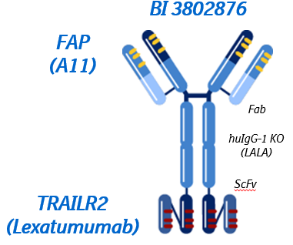
Asset overview
Drug candidate
  BI 3802876 is a bispecific molecule binding FAP and TRAILR2.
Clinical hypothesis
  Selectively removing FAP+ TRAILR2+ activated Hepatic Stellate Cells will halt/reverse liver fibrosis
Unique MOA
  Directly targeting the source of liver fibrosis
  FAP binding provides cell specificity and clusters TRAILR2 mediates cell killing
Indication
  MASH cF4 is a sentinel population with the potential to expand to other etiologies as a Pan-Cirrhotic Therapy
Treatment paradigm
  Intravenous drug, monthly or longer
  Short term/Cycling/Induction therapy
Competition
  No direct clinical competition for MoA in MASH
Pre-clinical results
  Demonstrated anti-fibrotic PoC in LiverChip (in vitro) fibrosis model with clinically relevant biomarkers (see next slide)
Phase I results
  BI 3802876 may cause small increases in hs-cTnT, which are of uncertain clinical significance at this time.
Notes:
BI 3802876 will selectively target FAP+ hepatic stellate cells for apoptosis. Activated hepatic stellate cells (aHSC) are considered as the main drivers of liver fibrosis. It is now known that aHSC’s express Fibroblast activation protein (FAP) and TRAILR2 receptors on their cell surface and the number of cells expressing these proteins correlates with histological severity of liver fibrosis in NASH patients as well as in other aetiologies, including Hepatitis C and Alcoholic Liver disease.
可以特异性地靶向活化的星状细胞以用双特异性抗体诱导凋亡。通过通过FAP锚定BI 3802876，该双特异性抗体通过TRAILR2受体诱导活化星状细胞的凋亡，从而预防纤维化的进展，随后纤维化的潜在逆转
TRAILR2 TNF相关凋亡诱导配体受体2（TRAILR2）

Slide 4
Possibility of PK backloading: Low
 | Rationale
Sensitivity to ethnic factors | PK profile: non-linear PK, as NBE normally no ethnic difference in PK expected, the expression of FAP and total FAP (sFAP) may impact PK, the expression in Asian is unclear Impact of body weight: limited if dosing is BW based Impact of metabolic enzyme and transporter polymorphism: no impact expected
Nonclinical Safety | No critical risks identified . The nonclinical safety package supports the safe administration of BI 3802876 to humans. Safety margins to NOAEL: Cmax (x48), AUC (x81) at 7.5 mg/kg
Clinical Safety (SRD&MRD) | BI 3802876 may cause small increases in hs-cTnT, which are of uncertain clinical significance at this time.
Safety information from other medications with the same MOA | Data around other TRAILR2 agonists suggests hepatotoxicity as a potential risk associated
Asian data | Absence of Asian data
Safety monitoring in Phase 2 trial | Exclude patients with CV risk and close monitor troponin T , NT-proBNP and other biomarkers.
Exposure in patient | TDO not available

Slide 5
Different HA interaction strategy by China and Japan
Japan
In line with a lean development approach, Japan team will focus on consulting with PMDA regarding the backloading of the Phase 1 trial in Japan.
If the feedback is positive, Japan will not participate in the Asian Phase 1 trial.
​
China
Due to certain risks associated with the Asian Phase 1 trial design, China team intends to conduct a consultation aimed at explaining the rationale behind PK backloading and gathering feedback on the Phase 1 trial design.
Although the number of Chinese patients in the Asian Phase 1 is limited, the data may still provide valuable support to meet the requirements for intensive PK data.
​

Slide 6
Asian Phase1 Proposal
Trial objectives: Safety and PK
Trial population: MASH cirrhosis (same as global phase 2a trial)
Trial design: open-label (no placebo), two-dose group cohorts , single dose administration
Participant country: China and Japan (based on HA interaction feedback)
Number of patients: 9pts
  Japan : 3pts + 3pts in Dosing Group 1 &2 (Total: 6 pts)
  China: Skip Dosing group 1 , 3pts in Dosing group 2 (Total 3pts)
Overall design of the trial
Subject identification
Run-in
MABEL
DG 2
Single dose
Safety PK observation
60 days
MABEL: Minimal Anticipated Biological Effect Level = 0.05mg/kg
Dose Escalation Committee: DEC after 30days safety observation in DG1
DEC
Subject identification
Run-in
MABEL
DG 1
Single dose
Safety PK observation
60 days

Slide 7
Global and Asian timeline (Asian phase 1)
Scenario 1: Both PMDA and CDE request Asian data before moving forward to phase 2b.
Scenario 2: PMDA requests Asian data, while CDE agrees to the PK backloading; China will remain involved in the Asian phase 1 to gather early data, potentially allowing for the waiver of an extensive PK study..
TDO?
2026 | 2027 | 2028 | 2029 | 2030
global
1517-0002 (Ph2a) in MASH cirrhosis
FSS~LSO: 2026/Jan~2027/Feb
1517-0008 (Ph2b) in MASH cirrhosis FSS~LSO: 2028/Jan ~2030/Feb
DG1 DEC
DG2 DEC
Key results
Type C Meeting
CTA sub.
~ 1 year enrollment
Jul/06
Oct/19
Jun
Oct
Apr/15
China
Joint Pre-INA
kick-off
CDE feedback
CTA
Sub.
Dose group 2
N=3
CTA sub.
1517-0008 (Ph2b) FSS~LSO: 2028/May ~2030/Feb
Pre-IND
Sub.
1st site
Initiation
Dec/01
Jun/05
Nov
06/01
Sep/01
Jan/05
Jul-Oct
~ 9 months enrollment
Asian Phase 1 in MASH cirrhosis FSS~LSO: 2027/Mar~2027/Oct
Japan
Dose group 2
N=3
CTA
Sub.
Dose group 1
N=3
CTA sub.
1517-0008 (Ph2b) FSS~LSO: 2028/Apr ~2030/Feb
Joint Pre-INA
kick-off
PMDA
Pre-IND Sub.
PMDA feedback
Jul-Oct
Nov/09
Jan
Dec/14-21
Jan/29
06/01
Mar-Jul
Notes:
CDE 同意backloading: 参考PMDA对日本的要求
CDE不同意backloading：中国最大的不确定是skip low dose

Slide 8
Global and Asian timeline (China alone phase 1)
Scenario 3: only CDE request the Asian data before joining phase 2b
TDO?
2026 | 2027 | 2028 | 2029 | 2030
global
1517-0002 (Ph2a) FSS~LSO: 2026/Jan~2027/Feb
1517-0008 (Ph2b) FSS~LSO: 2028/Jan ~2030/Feb
DG1 DEC
DG2 DEC
Key results
Type C Meeting
CTA sub.
~ 1 year enrollment
Jul/06
Oct/19
Jun
Oct
Apr/15
China
Joint Pre-INA
kick-off
CDE feedback
CTA
Sub.
Dose group 1
N=3
Dose group 2
N=6
CTA sub.
1517-0008 (Ph2b) FSS~LSO: 2028/Sep~2030/Feb
Pre-IND
Sub.
Dec/01
Jun-Oct
27 Oct- 28 Feb
Mar
06/01
Sep/01
Jan/05
China Phase 1 FSS~LSO: 2027/Jun~2028/Feb
~ 5 months enrollment
Japan
Joint Pre-INA
kick-off
PMDA
Pre-IND Sub.
PMDA feedback
CTA sub.
1517-0008 (Ph2b) FSS~LSO: 2028/Jan ~2030/Feb
Nov/09
Nov
06/01
Dec/14-21
Notes:
CDE 同意backloading: 参考PMDA对日本的要求
CDE不同意backloading：中国最大的不确定是skip low dose

Slide 9
Key Issue/Risk and Potential Impact
Key Risk /Issue
Mitigation
Risk : CDE may not agree with the limited patient number of the Asian phase 1 trial, particular in dose group 1 (n=3).
Risk 2: internal competition of three MASH cirrhosis trial may impact enrollment capability
Mitigation: 1) Emphasize that the trial is not the first human study but seeks to connect data between Asian and Caucasian patients; 2) present global data to reinforce the existing evidence
Mitigation: prevent overlap in site selection

Slide 10


Closing Slide
Team Proposal/Key Messages
Requested Decision to PEC
ASK FOR PEC'S ENDORSEMENT:
China HA interaction strategy and timeline
Joint Asian phase 1 plan

Slide 11
updated
China timeline
Japan timeline
updated
Task Name | Duration | Start | Finish
CTP development | 140 edays | 2026-07-20 | 2026-12-07
CTN prep | 21.38 edays | 2027-01-07 | 2027-01-28
CTN | 1 days | 2027-01-29 | 2027-01-29
PMDA 30-day review | 30 edays | 2027-01-29 | 2027-02-28
IRB/contract | 30 edays | 2027-02-28 | 2027-03-30
DG1 Subject identification | 60 edays | 2027-03-30 | 2027-05-29
First Subject Screened | 0 days | 2027-05-29 | 2027-05-29
DG1 dosing (MABEL) | 24 days | 2027-05-29 | 2027-06-22
DG1 dosing (target dose) | 0 edays | 2027-06-22 | 2027-06-22
DG1 safety observation | 28 edays | 2027-06-22 | 2027-07-20
DG1 PK observation | 60 edays | 2027-05-29 | 2027-07-21
DG1-DG2 DEC | 12 days | 2027-07-21 | 2027-08-05
DG2 subject identification | 60 edays | 2027-05-29 | 2027-07-28
DG2 dosing (MABEL) | 1 day | 2027-08-05 | 2027-08-29
DG2 dosing (target dose) | 1 day | 2027-08-29 | 2027-08-29
DG2 safety observation | 28 edays | 2027-08-29 | 2027-09-26
DG2 PK observation | 60 edays | 2027-08-29 | 2027-10-28
DBL | 40 days | 2027-10-29 | 2027-10-23
Christmas break | 10 days | 2027-12-24 | 2028-01-06
TLR | 5 days | 2028-01-07 | 2028-01-13
CTN for next phase trial | 10 days | 2028-01-14 | 2028-01-27
PMDA 14-day review | 15 edays | 2028-01-27 | 2028-02-11
IRB/contract | 45 edays | 2028-02-11 | 2028-03-27
Site initiation | 10 days | 2028-03-28 | 2028-04-10
JP FPI for next phase trial | 1 day | 2028-04-11 | 2028-04-11
Task Name | Comments | Start | Finish
CTP development |  | 2026-07-20 | 2026-12-07
CTA prep |  | 2026-01-07 | 2027-01-04
CTA submission |  | 2027-01-05
CDE review |  | 2027-01-05 | 2027-04-02
IRB/contract |  | 2027-01-05 | 2027-06-05
DG1 Subject identification | China not join DG1 due to the very limited window. Need to provide strong rationales why only 3 pts for DG1.
First Subject Screened
DG1 dosing (MABEL)
DG1 dosing (target dose)
DG1 safety observation
DG1 PK observation
DG1-DG2 DEC
DG2 subject identification |  | 2027-06-05 | 2027-07-28
DG2 dosing (MABEL) |  | 2027-08-05 | 2027-08-29
DG2 dosing (target dose) |  | 2027-08-29 | 2027-08-29
DG2 safety observation |  | 2027-08-29 | 2027-09-26
DG2 PK observation |  | 2027-08-29 | 2027-10-28
DBL |  | 2027-10-29 | 2027-10-23
Christmas break |  | 2027-12-24 | 2028-01-06
TLR | China will submit CTA in parallel with global. Snapshot of DG2 safety data be included in CTA submission. | 2028-01-07 | 2028-01-13
CTA for next phase trial
CDE review
IRB/contract
Site initiation
China FPI for next phase trial

Slide 12
China timeline (CDE request phase 1 but PMDA not)
Task Name | Comments | Start | Finish
CTP development |  | 2026-07-20 | 2026-12-07
CTA prep |  | 2026-01-07 | 2027-01-04
CTA submission |  | 2027-01-05
CDE review | CTA sub +60 w days | 2027-01-05 | 2027-04-02
IRB/contract | CTA sub+ 5 months | 2027-01-05 | 2027-06-05
DG1 Subject identification | Reservation prior to SIV | 2027-05-10 | 2027-07-09
DG1 Subject Screened (n=3) | SIV + max. 1 month | 2027-06-18 | 2027-07-09
DG1 dosing (MABEL) | Screen + max. 1 month | 2027-07-19 | 2027-08-10
DG1 dosing (target dose) | MABEL + 21 days | 2027-08-10 | 2027-08-31
DG1 safety observation | Target dose + 28 days | 2027-09-07 | 2027-09-28
DG1 PK observation | Target dose + 56 days | 2027-10-05 | 2027-10-26
DG1-DG2 DEC | Including national holidays | 2027-09-29 | 2027-10-20
DG2 subject identification | Reservation prior to DEC | 2027-07-10 | 2027-11-11
DG2 Subject Screened (n=6) | After DEC | 2027-10-21 | 2027-11-11
DG2 dosing (MABEL) | Screen + max 1 month | 2027-11-22 | 2027-12-12
DG2 dosing (target dose) | MABEL + 21 days | 2027-12-13 | 2028-01-02
DG2 safety observation | Target dose + 28 days | 2028-01-10 | 2028-01-30
DG2 PK observation | Target dose + 56 days | 2028-02-07 | 2028-02-27
DBL | Including sample exportation | 2028-03-02 | 2028-05-16
TLR | DBL + 1 month | 2028-06-16
CTA for next phase trial | DG2 safety data available +1 m | 2028-03-02
CDE review |  | 2028-03-02 | 2028-06-02
IRB/contract |  | 2028-03-02 | 2028-09-02
Site initiation | CTA sub+ 6 months | 2028-09-03
If PMDA accept backloading, but CDE requires Asian (Chinese) data before the next phase trial , a China alone phase 1 in China will be necessary.
Completion of the China phase 1 is 4 months behind the joint Asan phase 1, which will delay the enrollment of Chinese participants in the phase 2b trial.
The proposed mitigation strategy is to include the preliminary phase 1 data at the time of CTA submission.

Slide 13
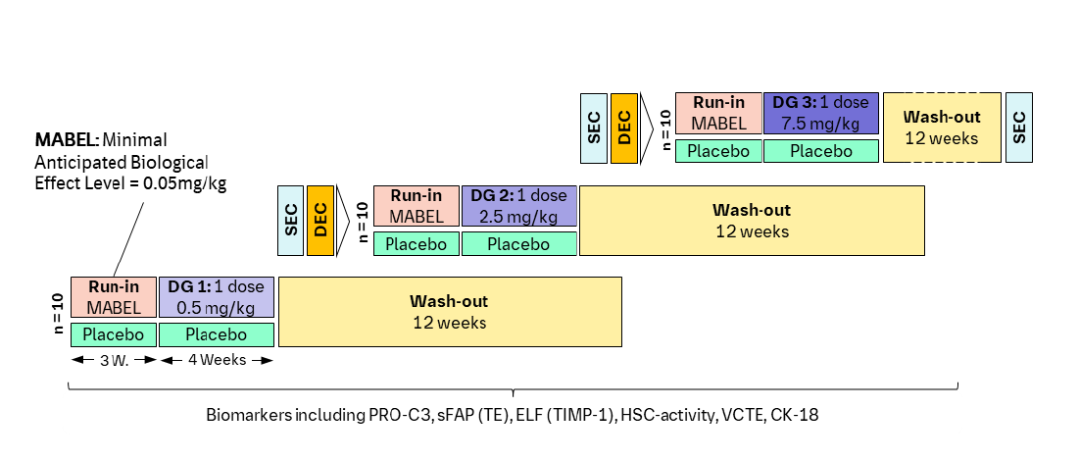
1517-0002 (Phase 2a trial)
A Phase IIa double-blind, placebo-controlled study evaluating the safety, tolerability, pharmacokinetics and pharmacodynamics of BI 3802876 in participants with compensated cirrhosis due to Metabolic Dysfunction-Associated Steatohepatitis (MASH)
N=30
Primary endpoints: AE
Secondary endpoints: PK (AUC, Cmax), PD (Pro-C3 at week 4)
Treatment period:
  Run-in (MABEL): 3 weeks
  Target dose: 4 weeks
  Follow up: 12 weeks from EoT

Slide 14
BD preparation timeline w/HAI
Japan/China
China
Japan
Task | Start | End | Duration
Synopsis of Phase2b | 5/29/2026 | 5/29/2026 | 1 日
Japan/China KOM | 6/1/2026 | 6/1/2026 | 1 日
D1 preparation (JP and CN team) | 6/2/2026 | 6/26/2026 | 19 日
D1 Review (JP and CN team) | 6/29/2026 | 7/6/2026 | 6 日
★DG1 DEC（Jul 6） | 7/6/2027 | 7/6/2027 | 1 日
D2 Preparation | 7/7/2026 | 7/20/2026 | 10 日
D2 Review (w/global) | 7/21/2026 | 7/27/2026 | 5 日
D3 Preparation | 7/28/2026 | 8/3/2026 | 5 日
Ph1 TDO | 4/1/2026 | 8/1/2026 | 4 months
Translation and formatting for CDE submission | 8/4/2026 | 8/28/2026 | 19 日
Translation and formatting for PMDA pre-mtg (pre-fix) | 8/4/2026 | 8/28/2026 | 19 日
Preparation of Pre-meeting | 8/31/2026 | 9/10/2026 | 9 日
Submission to PMDA pre-meeting | 9/11/2026 | 9/11/2026 | 1 日
Preliminary meeting | 9/25/2026 | 9/30/2026 | 4 日
Meeting Request to PMDA | 10/1/2026 | 10/1/2026 | 1日
D4 preparation incorporating PMDA's feedback | 10/1/2026 | 10/14/2026 | 10 日
D4 review | 10/15/2026 | 10/21/2026 | 5 日
★DG2 DEC（Oct19） | 10/19/2027 | 10/19/2027 | 1 日
D5 preparation incorporating DG2 data | 10/20/2027 | 10/27/2027 | 6 日
D5 review | 10/28/2027 | 11/3/2027 | 5 日
Finalization/formatting | 11/4/2027 | 11/8/2027 | 3 日
Submission to PMDA | 11/9/2027 | 11/9/2027 | 1 日
PMDA Query | 11/20/2026 | 11/20/2026 | 1 日
Response to Query | 11/27/2026 | 11/27/2026 | 1 日
Feedback from CDE | 12/1/2026 | 12/1/2026 | 1 日
PMDA preliminary opinion | 12/4/2026 | 12/4/2026 | 1 日
Response to PMDA opinion | 12/9/2026 | 12/9/2026 | 1 日
PMDA meeting | 12/14/2026 | 12/18/2026 | 5 日

Slide 15
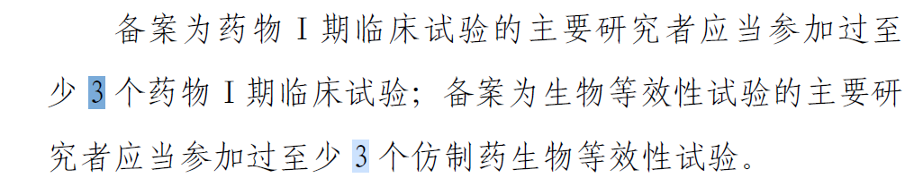
PI Qualification
药物Ⅰ期临床试验管理指导原则
Phase I study published in CDE platform _ as PI
北京友谊，尤红, 3 studies
杭州师范，施军平, 1 study
温州附一 ，郑明华, 1 study
南方医院，侯金林/陈金军, 3 studies
LIVERAGE cirrhosis enrollment for reference:
北京友谊 5 pts (30-Dec-24 ~ now)
杭州师范 2pts (21-Mar-25~now)
温州附一 1pt (25-Feb-25 ~now)
南方医院 1pt (21-Apr-25~now)

